Slide 1
Deep Learning
Dr. Mrunal Rane

Slide 2
Syllabus
Introduction to Deep Neural Network,
Wide Vs. Deep Neural Network,
Reasons to opt for deep neural network,
Deep Neural networks for unsupervised learning

Slide 3
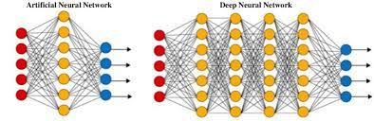
Introduction

Slide 4
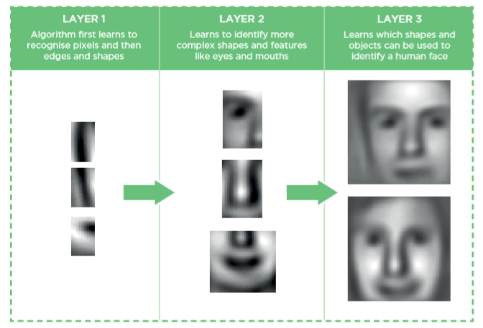
DL architecture

Slide 5
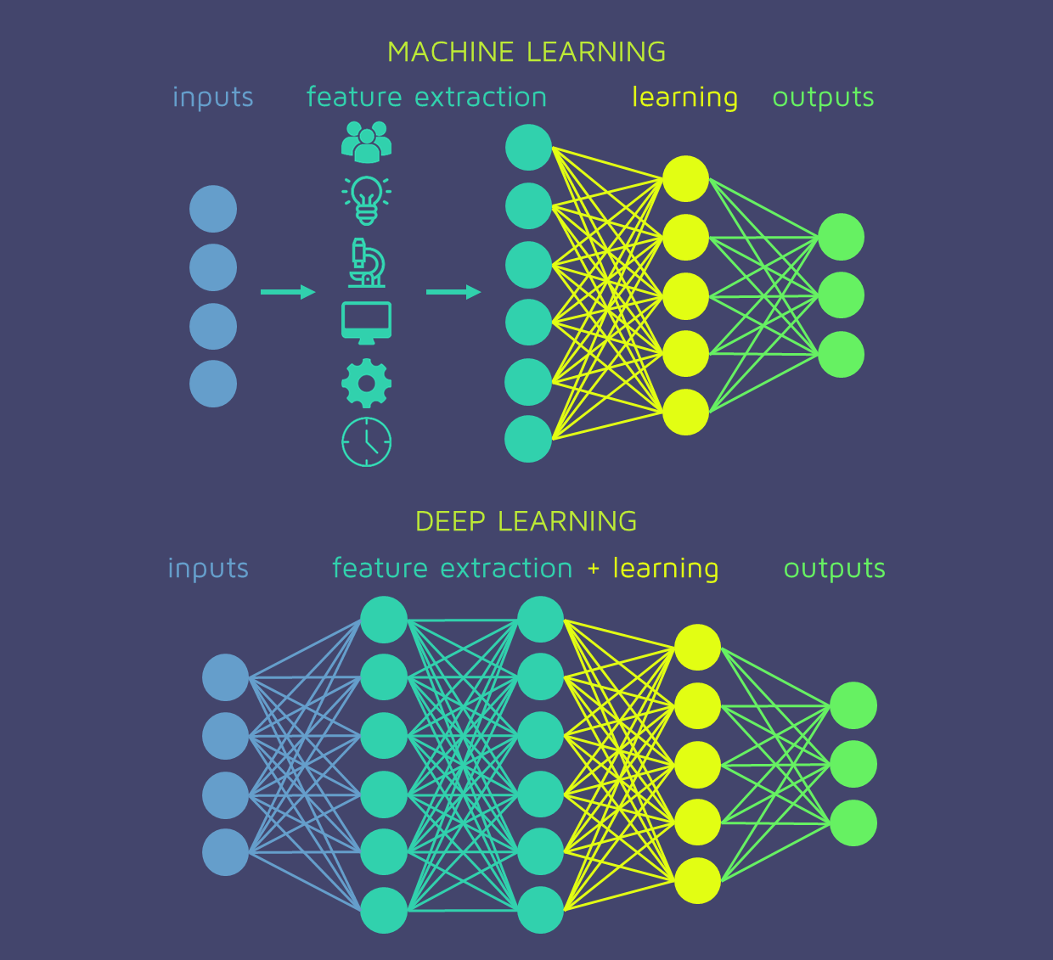
Notes:
Here are some key points regarding feature engineering in traditional machine learning:
Feature Selection: Domain experts often have valuable insights into which features are relevant for solving a particular problem. They can select a subset of features that are likely to have the most predictive power based on their understanding of the domain.
Feature Transformation: Features may need to be transformed to make them more suitable for modeling. This can include scaling features to a similar range, normalizing them to have zero mean and unit variance, or applying transformations such as logarithms or square roots to make the distribution of the feature more Gaussian-like.
Feature Creation: Domain knowledge can also be used to create new features that capture important relationships or interactions between existing features. For example, in a dataset containing height and weight, a domain expert might create a new feature representing body mass index (BMI), which could be a more informative predictor of health outcomes.
Handling Missing Values: Domain experts may be able to provide guidance on how to handle missing values in the data, such as imputing missing values with the mean, median, or mode of the feature, or using more sophisticated methods based on domain-specific knowledge.
DL
Automatic Feature Learning: Deep learning models can automatically learn features directly from raw data, such as images, text, or audio, without the need for handcrafted features. This is accomplished through the hierarchical composition of multiple layers of neurons, which progressively learn increasingly abstract and complex representations of the input data.
End-to-End Learning: Deep learning enables end-to-end learning, where the entire system, from input to output, is learned directly from data. This allows the model to optimize all aspects of the task simultaneously, without the need for manual feature extraction, preprocessing, or intermediate steps.
Representation Learning: Deep learning models are capable of learning representations of the input data that are optimized for the task at hand. These learned representations capture useful information about the underlying structure and patterns in the data, making them well-suited for a wide range of tasks, including classification, regression, and generation.
Flexibility and Adaptability: Deep learning models are highly flexible and adaptable to different types of data and tasks. They can learn from large and complex datasets with minimal human intervention, making them suitable for a wide range of applications in various domains, including computer vision, natural language processing, speech recognition, and reinforcement learning.
Transfer Learning: Deep learning models trained on large-scale datasets can be fine-tuned or transferred to related tasks with smaller datasets. This allows for efficient reuse of learned features and knowledge across different tasks, domains, or datasets, reducing the need for extensive labeled data and training time.

Slide 6
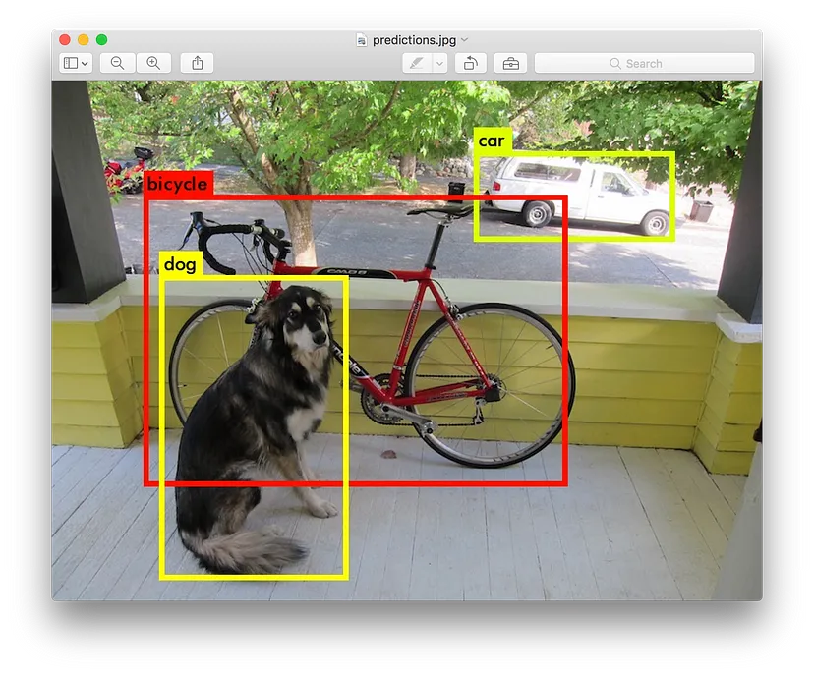
Yolo Net

Slide 7
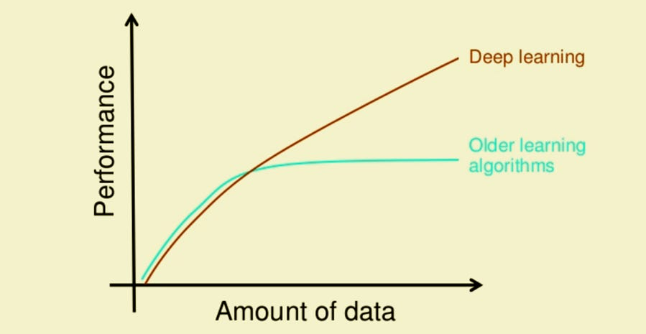
Deep Learning
“The analogy to deep learning is that the rocket engine is the deep learning models and the fuel is the huge amounts of data we can feed to these algorithms.”

Slide 8
When to use Deep Learning or not over others?
Deep Learning out perform other techniques if the data size is large. But with small data size, traditional Machine Learning algorithms are preferable.
Deep Learning techniques need to have high end infrastructure to train in reasonable time.
When there is lack of domain understanding for feature introspection, Deep Learning techniques outshines others as you have to worry less about feature engineering.
Deep Learning really shines when it comes to complex problems such as image classification, natural language processing, and speech recognition.

Slide 9
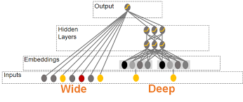
Wide Vs. Deep Neural Network
Notes:
Wide Neural Networks:
Wide neural networks typically refer to networks with a large number of neurons in a single layer or a small number of layers. These networks have a wide layer that captures a broad range of features simultaneously.
The wide layer allows the network to memorize complex patterns and relationships in the data. It's particularly effective when the data has a high dimensionality or contains interactions between many features.
Wide neural networks are often used in recommendation systems, where the goal is to predict user preferences based on a large number of features (e.g., user demographics, browsing history, and item attributes).
These types of networks can be useful when you have less data and your problem isn't too complex. Single hidden layer with a lot of neurons can detect simple patterns(simple classification and regression problems) in the dataset but will fail when you start expecting it to detect complex relations (Image detection, Speech recognition, etc.).
Deep Neural Networks:
Deep neural networks, on the other hand, refer to networks with multiple layers between the input and output layers. These networks have a deep architecture that enables them to learn hierarchical representations of the input data.
Each layer in a deep neural network learns increasingly abstract and complex features from the previous layer's representations. This hierarchical learning allows deep networks to capture intricate patterns and relationships in the data.
Deep neural networks are widely used in various domains, including computer vision, natural language processing, speech recognition, and reinforcement learning. Convolutional neural networks (CNNs) and recurrent neural networks (RNNs) are popular architectures for image and sequence data, respectively.

Slide 10
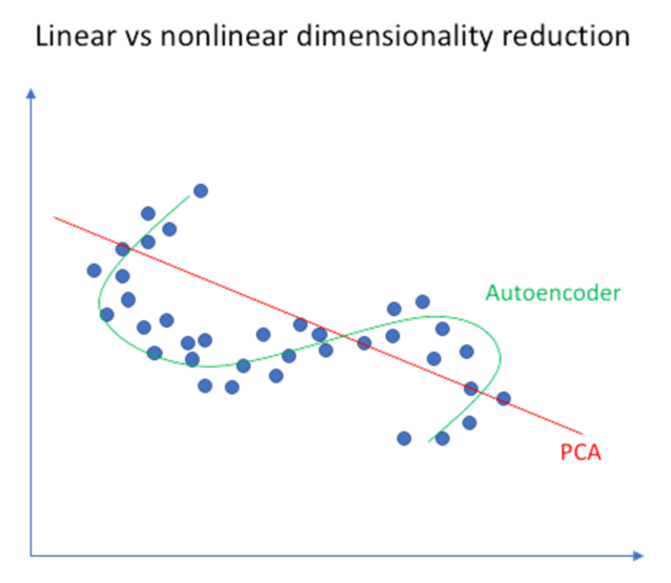
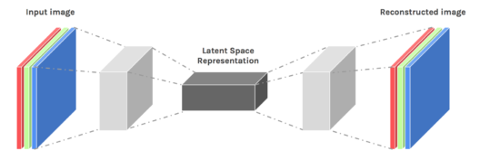
DNN for unsupervised learning
An autoencoder can learn non-linear transformations with a non-linear activation function and multiple layers.
Representation of each layer as the output.
It doesn’t have to learn dense layers.
It is more efficient to learn several layers with an autoencoder rather than learn one huge transformation with PCA.
It can make use of pre-trained layers from another model
Notes:
Autoencoders:
Autoencoders are neural network architectures that aim to learn efficient representations of the input data by encoding it into a lower-dimensional latent space and then reconstructing the original input from this representation.
The encoder network maps the input data to the latent space, typically with a bottleneck layer that contains a lower number of neurons than the input layer. The decoder network then reconstructs the input data from the latent representation.
By training the autoencoder to minimize the reconstruction error between the input and the reconstructed output, the network learns to capture meaningful features and patterns in the data.

Slide 11
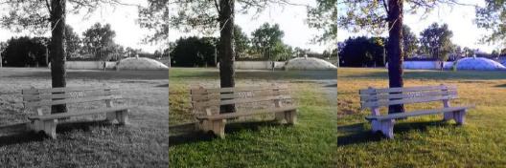
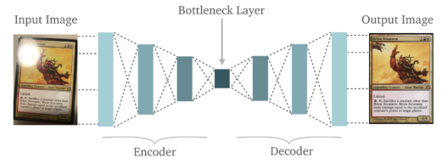
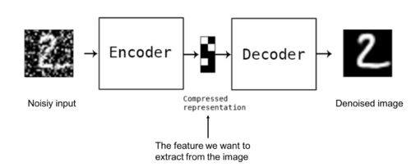
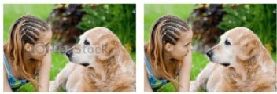
Applications
Image Colouring
Feature Extraction
Removing Watermarks
Denoising Image
Notes:
Image Coloring
Autoencoders are used for converting any black and white picture into a colored image. Depending on what is in the picture, it is possible to tell what the color should be.
Feature variation
It extracts only the required features of an image and generates the output by removing any noise or unnecessary interruption.
Denoising
The input seen by the autoencoder is not the raw input but a stochastically corrupted version. A denoising autoencoder is thus trained to reconstruct the original input from the noisy version.

Slide 12
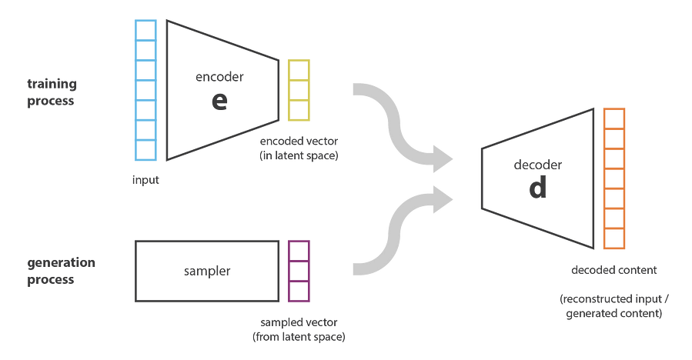
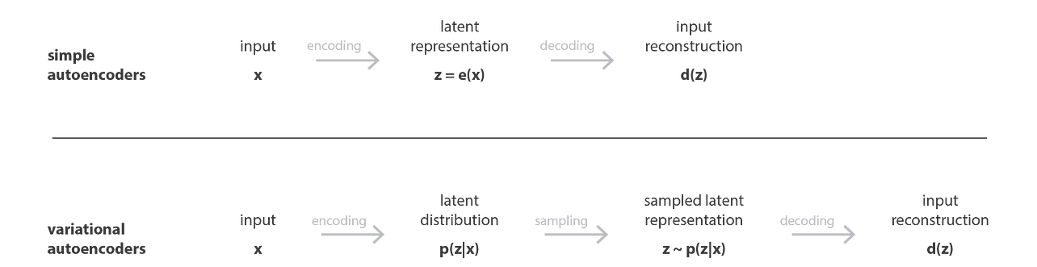
DNN
Variational Autoencoders (VAEs):a variant of autoencoders that learn a probabilistic distribution over the latent space, allowing for the generation of new data samples.

Slide 13
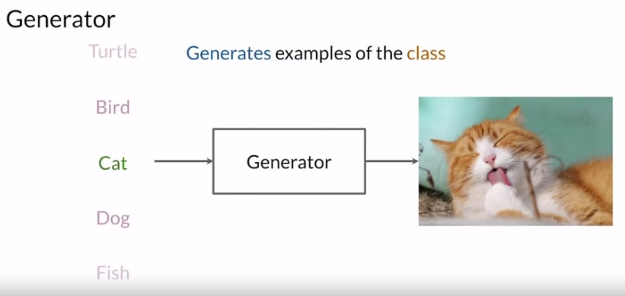
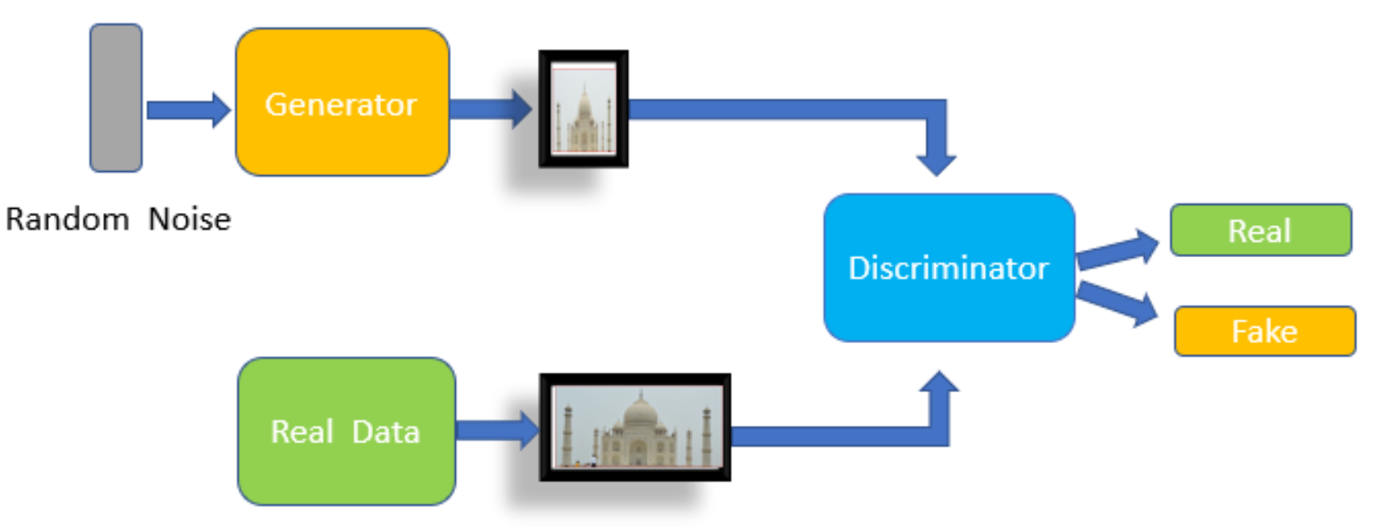
DNN
Generative Adversarial Networks (GANs):consist of two neural networks, a generator and a discriminator, that are trained simultaneously in a competitive manner.
Notes:
The generative approach is an unsupervised learning method in machine learning which involves automatically discovering and learning the patterns or regularities in the given input data in such a way that the model can be used to generate or output new examples that plausibly could have been drawn from the original dataset Their applications include image generation, video generation, and voice generation.
GANs can generate images from textual descriptions.
The generator’s goal is to be able to produce synthetic examples from a certain input. So if you trained it from the class of a cat, then the generator will do some computations and output a representation of a cat that looks real.
So ideally, the generator won’t output the same cat at every run, and so to ensure it’s able to produce different examples every single time, the input will be different sets of random values, known as a noise vector. For example, the noise vector can be 1, 2, 5, 1.5, 5, 5, 2. Then this noise vector is fed in as input. After the training, the generator model is used to generate new samples.

